Slide 1
Outline
Introduction
Background
Distributed Database Design
Database Integration
Semantic Data Control
Distributed Query Processing
Overview
Query decomposition and localization
Distributed query optimization
Multidatabase query processing
Distributed Transaction Management
Data Replication
Parallel Database Systems
Distributed Object DBMS
Peer-to-Peer Data Management
Web Data Management
Current Issues

Slide 2
Step 1 – Query Decomposition
Input : Calculus query on global relations
Normalization
manipulate query quantifiers and qualification
Analysis
detect and reject “incorrect” queries
possible for only a subset of relational calculus
Simplification
eliminate redundant predicates
Restructuring
calculus query ➔ algebraic query
more than one translation is possible
use transformation rules

Slide 3
Normalization
Lexical and syntactic analysis
check validity (similar to compilers)
check for attributes and relations
type checking on the qualification
Put into normal form
Conjunctive normal form
(p₁₁∨ p₁₂ ∨ … ∨ p_{1n}) ∧ … ∧ (p_{m1} ∨ p_{m2} ∨ … ∨ p_{mn})
Disjunctive normal form
(p₁₁ ∧ p₁₂ ∧ … ∧ p_{1n}) ∨ … ∨ (p_{m1} ∧ p_{m2} ∧ … ∧ p_{mn})
OR's mapped into union
AND's mapped into join or selection

Slide 4
Analysis
Refute incorrect queries
Type incorrect
If any of its attribute or relation names are not defined in the global schema
If operations are applied to attributes of the wrong type
Semantically incorrect
Components do not contribute in any way to the generation of the result
Only a subset of relational calculus queries can be tested for correctness
Those that do not contain disjunction and negation
To detect
connection graph (query graph)
join graph

Slide 5
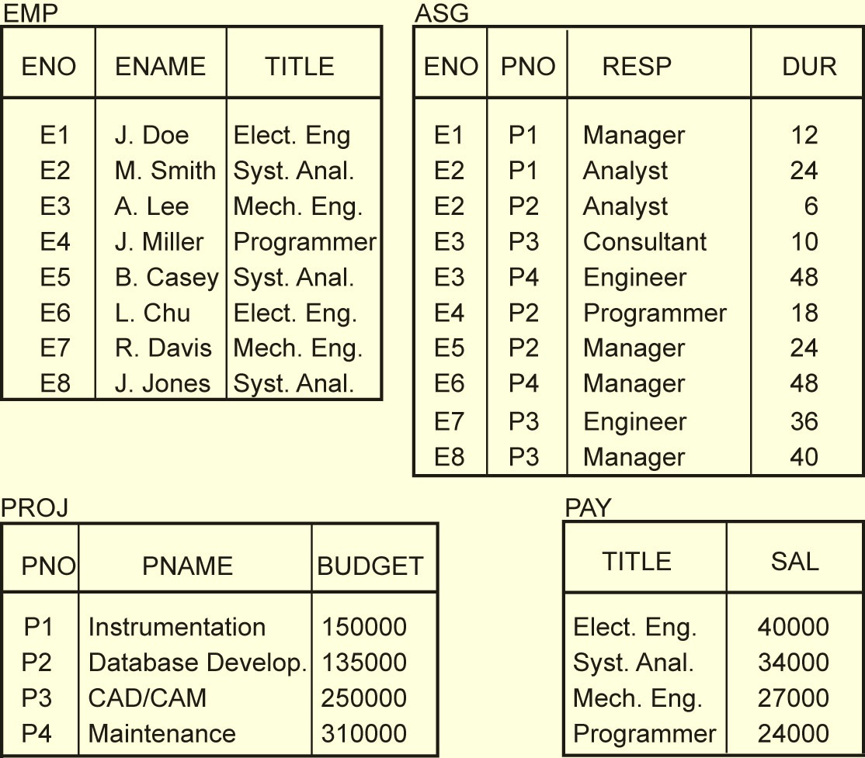
Normalized Relations – Example

Slide 6
Analysis – Example
SELECT ENAME,RESP
FROM EMP, ASG, PROJ
WHERE EMP.ENO = ASG.ENO
AND ASG.PNO = PROJ.PNO
AND PNAME = "CAD/CAM"
AND DUR ≥ 36
AND TITLE = "Programmer"
Query graph
Join graph
DUR≥36
ASG
ASG
EMP.ENO=ASG.ENO
ASG.PNO=PROJ.PNO
EMP.ENO=ASG.ENO
ASG.PNO=PROJ.PNO
TITLE =
“Programmer”
EMP
RESP
PROJ
EMP
PROJ
ENAME
RESULT
PNAME=“CAD/CAM”

Slide 7
Analysis
If the query graph is not connected, the query may be wrong or use Cartesian product
SELECT ENAME,RESP
FROM EMP, ASG, PROJ
WHERE EMP.ENO = ASG.ENO
AND PNAME = "CAD/CAM"
AND DUR > 36
AND TITLE = "Programmer"
ASG
EMP
RESP
PROJ
ENAME
RESULT
PNAME=“CAD/CAM”

Slide 8
Simplification
Why simplify?
Remember the example
How? Use transformation rules
Elimination of redundancy
idempotency rules
p₁ ∧ ¬( p₁) ⇔ false
p₁ ∧ (p₁∨ p₂) ⇔ p₁
p₁ ∧ false ⇔ p₁
…
Application of transitivity
Use of integrity rules

Slide 9
Simplification – Example
SELECT TITLE
FROM EMP
WHERE EMP.ENAME = "J. Doe"
OR (NOT(EMP.TITLE = "Programmer")
AND (EMP.TITLE = "Programmer"
OR EMP.TITLE = "Elect. Eng.")
AND NOT(EMP.TITLE = "Elect. Eng."))
⬇
SELECT TITLE
FROM EMP
WHERE EMP.ENAME = "J. Doe"

Slide 10
Restructuring
Convert relational calculus to relational algebra
Make use of query trees
Example
Find the names of employees other than J. Doe who worked on the CAD/CAM project for either 1 or 2 years.
SELECT ENAME
FROM EMP, ASG, PROJ
WHERE EMP.ENO = ASG.ENO
AND ASG.PNO = PROJ.PNO
AND ENAME≠ "J. Doe"
AND PNAME = "CAD/CAM"
AND (DUR = 12 OR DUR = 24)
Π_{ENAME}
Project
σ_{DUR=12 OR DUR=24}
σ_{PNAME=“CAD/CAM”}
Select
σ_{ENAME≠“J. DOE”}
⋈_{PNO}
⋈_{ENO}
Join
PROJ
ASG
EMP

Slide 11
Restructuring –Transformation Rules
Commutativity of binary operations
R × S ⇔ S × R
R ⋈S ⇔ S ⋈R
R ∪ S ⇔ S ∪ R
Associativity of binary operations
( R × S) × T ⇔ R × (S × T)
(R ⋈S) ⋈T ⇔ R ⋈ (S ⋈T)
Idempotence of unary operations
Π_{A’}(Π _{A’}(R)) ⇔ Π _{A’}(R)
σ_{p1(A1)}(σ_{p2(A2)}(R)) ⇔ σ_{p1(A1)∧p2(A2)}(R)
where R[A] and A' ⊆ A, A" ⊆ A and A' ⊆ A"
Commuting selection with projection

Slide 12
Restructuring – Transformation Rules
Commuting selection with binary operations
σ_{p(A)}(R × S) ⇔ (σ_{p(A)} (R)) × S
σ_{p(Ai)}(R ⋈_{(Aj,Bk)}S) ⇔ (σ_{p(Ai)} (R)) ⋈_{(Aj,Bk)}S
σ_{p(Ai)}(R ∪ T) ⇔ σ_{p(Ai)} (R) ∪ σ_{p(Ai)} (T)
where A_{i} belongs to R and T
Commuting projection with binary operations
Π_{C}(R × S) ⇔ Π_{A’}(R) × Π_{B’}(S)
Π_{C}(R ⋈_{(Aj,Bk)}S) ⇔ Π_{A’}(R) ⋈_{(Aj,Bk)} Π_{B’}(S)
Π_{C}(R ∪ S) ⇔ Π_{C}(R) ∪ Π_{C}(S)
where R[A] and S[B]; C = A' ∪ B' where A' ⊆ A, B' ⊆ B

Slide 13
Example
Recall the previous example:
Find the names of employees other than J. Doe who worked on the CAD/CAM project for either one or two years.
SELECT ENAME
FROM PROJ, ASG, EMP
WHERE ASG.ENO=EMP.ENO
AND ASG.PNO=PROJ.PNO
AND ENAME ≠ "J. Doe"
AND PROJ.PNAME="CAD/CAM"
AND (DUR=12 OR DUR=24)
Π_{ENAME}
Project
σ_{DUR=12 ∧ DUR=24}
σ_{PNAME=“CAD/CAM”}
Select
σ_{ENAME≠“J. DOE”}
⋈_{PNO}
⋈_{ENO}
Join
PROJ
ASG
EMP

Slide 14
Equivalent Query
Π_{ENAME}
σPNAME=“CAD/CAM” ∧ (DUR=12 ∧ DUR=24) ∧ENAME≠“J. Doe”
⋈_{PNO,ENO}
×
EMP
PROJ
ASG

Slide 15
Restructuring
Π_{ENAME}
⋈_{PNO}
Π_{PNO,ENAME}
⋈_{ENO}
Π_{PNO}
Π_{PNO,ENO}
Π_{PNO,ENAME}
σ_{PNAME = "CAD/CAM"}
σ_{DUR =12∧DUR=24}
σ_{ENAME ≠ "J. Doe"}
PROJ
ASG
EMP

Slide 16
Step 2 – Data Localization
Input: Algebraic query on distributed relations
Determine which fragments are involved
Localization program
substitute for each global query its materialization program
optimize

Slide 17
Example
Assume
EMP is fragmented into EMP₁, EMP₂, EMP₃ as follows:
EMP₁= σ_{ENO≤“E3”}(EMP)
EMP₂= σ_{“E3”<ENO≤“E6”}(EMP)
EMP₃= σ_{ENO≥“E6”}(EMP)
ASG fragmented into ASG₁ and ASG₂ as follows:
ASG₁= σ_{ENO≤“E3”}(ASG)
ASG₂= σ_{ENO>“E3”}(ASG)
Replace EMP by (EMP₁ ∪ EMP₂ ∪ EMP₃)
and ASG by (ASG₁ ∪ ASG₂) in any query
Π_{ENAME}
σ_{DUR=12 ∧DUR=24}
σ_{PNAME=“CAD/CAM”}
σ_{ENAME≠“J. DOE”}
⋈_{PNO}
⋈_{ENO}
PROJ
∪
∪
EMP₁
EMP₂
EMP₃
ASG₁
ASG₂

Slide 18
Provides Parallellism
∪
⋈_{ENO}
⋈_{ENO}
⋈_{ENO}
⋈_{ENO}
EMP₁
ASG₁
EMP₂
ASG₂
EMP₃
ASG₁
EMP₃
ASG₂

Slide 19
Eliminates Unnecessary Work
∪
⋈_{ENO}
⋈_{ENO}
⋈_{ENO}
EMP₁
ASG₁
EMP₂
ASG₂
EMP₃
ASG₂

Slide 20
Reduction for PHF
Reduction with selection
Relation R and F_{R}={R₁, R₂, …, R_{w}} where R_{j}=σ_{pj}(R)
σ_{pi}(R_{j})=∅ if ∀x in R: ¬(p_{i}(x)∧ p_{j}(x))
Example
SELECT *
FROM EMP
WHERE ENO="E5"
σ_{ENO=“E5”}
σ_{ENO=“E5”}
∪
EMP₁
EMP₂
EMP₃
EMP₂

Slide 21
Reduction for PHF
Reduction with join
Possible if fragmentation is done on join attribute
Distribute join over union
(R₁∪ R₂)⋈S ⇔ (R₁⋈S) ∪ (R₂⋈S)
Given R_{i} =σ_{pi}(R) and R_{j} = σ_{pj}(R)
R_{i} ⋈R_{j} =∅ if ∀x in R_{i}, ∀y in R_{j}: ¬(p_{i}(x)∧ p_{j}(y))

Slide 22
Reduction for PHF
Assume EMP is fragmented as before and
ASG₁: σ_{ENO ≤ "E3"}(ASG)
ASG₂: σ_{ENO > "E3"}(ASG)
Consider the query
SELECT *
FROM EMP,ASG
WHERE EMP.ENO=ASG.ENO
Distribute join over unions
Apply the reduction rule
⋈_{ENO}
∪
∪
EMP₁
EMP₂
EMP₃
ASG₁
ASG₂
∪
⋈_{ENO}
⋈_{ENO}
⋈_{ENO}
EMP₁
ASG₁
EMP₂
ASG₂
EMP₃
ASG₂

Slide 23
Reduction for VF
Find useless (not empty) intermediate relations
Relation R defined over attributes A = {A₁, ..., A_{n}} vertically fragmented as R_{i} =Π_{A'}(R) where A'⊆ A:
Π_{D,K}(R_{i}) is useless if the set of projection attributes D is not in A'
Example: EMP₁=Π_{ENO,ENAME} (EMP); EMP₂=Π_{ENO,TITLE} (EMP)
SELECT ENAME
FROM EMP
Π_{ENAME}
Π_{ENAME}
⋈_{ENO}
EMP₁
EMP₂
EMP₁

Slide 24
Reduction for DHF
Rule :
Distribute joins over unions
Apply the join reduction for horizontal fragmentation
Example
ASG₁: ASG ⋉_{ENO} EMP₁
ASG₂: ASG ⋉_{ENO} EMP₂
EMP₁: σ_{TITLE=“Programmer”} (EMP)
EMP₂: σ_{TITLE=“Programmer”} (EMP)
Query
SELECT *
FROM EMP, ASG
WHERE ASG.ENO = EMP.ENO
AND EMP.TITLE = "Mech. Eng."

Slide 25
Reduction for DHF
Generic query
⋈_{ENO}
σ_{TITLE=“Mech. Eng.”}
∪
∪
ASG₁
ASG₂
EMP₁
EMP₂
Selections first
⋈_{ENO}
∪
σ_{TITLE=“Mech. Eng.”}
ASG₁
ASG₂
EMP₂

Slide 26
Reduction for DHF
Joins over unions
∪
⋈_{ENO}
⋈_{ENO}
σ_{TITLE=“Mech. Eng.”}
σ_{TITLE=“Mech. Eng.”}
ASG₁
EMP₂
ASG₂
EMP₂
Elimination of the empty intermediate relations
(left sub-tree)
⋈_{ENO}
σ_{TITLE=“Mech. Eng.”}
ASG₂
EMP₂

Slide 27
Reduction for Hybrid Fragmentation
Combine the rules already specified:
Remove empty relations generated by contradicting selections on horizontal fragments;
Remove useless relations generated by projections on vertical fragments;
Distribute joins over unions in order to isolate and remove useless joins.

Slide 28
Reduction for HF
Example
Consider the following hybrid fragmentation:
EMP₁= σ_{ENO≤"E4"} (Π_{ENO,ENAME} (EMP))
EMP₂= σ_{ENO>"E4"} (Π_{ENO,ENAME} (EMP))
EMP₃= σ_{ENO,TITLE} (EMP)
and the query
SELECT ENAME
FROM EMP
WHERE ENO="E5"
Π_{ENAME}
Π_{ENAME}
σ_{ENO=“E5”}
⇒
σ_{ENO=“E5”}
⋈_{ENO}
∪
EMP₂
EMP₁
EMP₂
EMP₃

